Slide 1
PUBLIC KEY INFRASTRUCTURE

Slide 2

DEFINITION: Public-key infrastructure (PKI) as the set of hardware, software, people, policies, and procedures needed to create, manage, store, distribute, and revoke digital certificates based on asymmetric cryptography.
The principal objective for developing a PKI is to enable secure, convenient, and efficient obtain of public keys.
PKI builds on X.509 known as PKIX for certificate standardization., contains protocols and specifications that is suitable for deploying a certificate-based architecture on the Internet.
PKI includes message digests(Integrity),Digital signatures that is for Authentication,Encryption services(Confidentiality).

Slide 3
End entity: A generic term used to denote end users, devices (e.g., servers, routers), or any other entity that can be identified in the subject field of a public-key certificate. End entities typically consume and/or support PKI-related services.
2.Certification authority (CA): The issuer of certificates and (usually) certificate revocation lists (CRLs). It may also support a variety of administrative functions, although these are often delegated to one or more Registration Authorities.
3.Registration authority (RA): An optional component that can assume a number of administrative functions from the CA. The RA is often associated with the end entity registration process but can assist in a number of other areas as well.
4.CRL issuer: An optional component that a CA can delegate to publish CRLs.
5.Repository: A generic term used to denote any method for storing certificates and CRLs so that they can be retrieved by end entities.

Slide 4

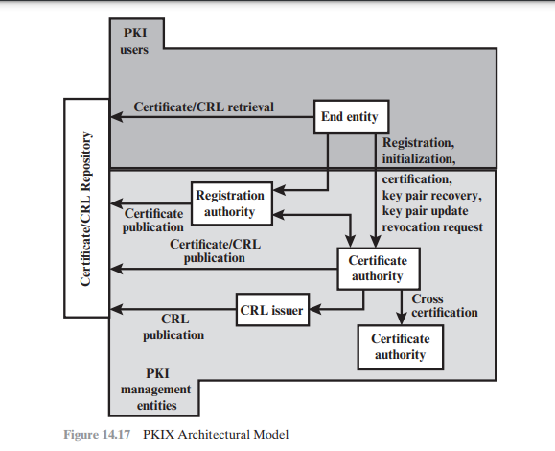

Slide 5
PKIX MANAGEMENT FUNCTIONS:
■ Registration: This is the process whereby a user first makes itself known to a CA (directly or through an RA), prior to that CA issuing a certificate or certificates for that user. Registration begins the process of enrolling in a PKI. Registration usually involves some offline or online procedure for mutual authentication. Typically, the end entity is issued one or more shared secret keys used for subsequent authentication.
■ Initialization: Before a client system can operate securely, it is necessary to install key materials that have the appropriate relationship with keys stored elsewhere in the infrastructure. For example, the client needs to be securely initialized with the public key and other assured information of the trusted CA(s), to be used in validating certificate paths.
■ Certification: This is the process in which a CA issues a certificate for a user’s public key, returns that certificate to the user’s client system, and/or posts that certificate in a repository.

Slide 6

Key pair recovery: It's essential for digital signature and encryption purposes, ensuring access to decryption keys if normal access to key material is lost due to forgotten passwords, corrupted drives, or hardware issues. Recovery typically involves restoring encryption/decryption keys from an authorized backup facility, often the certificate authority (CA).
Key pair update: Regular updates of key pairs are necessary to maintain security. This involves replacing existing key pairs with new ones and issuing new certificates. Updates are triggered by certificate expiration or revocation events.
Revocation request: Authorized individuals inform the CA about situations requiring certificate revocation, such as compromised private keys or changes in affiliation or name. Revocation ensures that compromised or invalid certificates are no longer trusted
Cross certification: Two CAs exchange information to establish a cross-certificate, which is a certificate issued by one CA to another containing a CA signature key. Cross-certificates facilitate trust between different PKIs, enabling interoperability and trust across organizational boundaries.

Slide 7
THANK YOU

